Slide 1
Intuit Craft Demo
Attri Ghosal

Slide 2
Contents
Introduction
Problem Statement
Solution
Algorithm
LLD
Code Walkthrough
Solving this in real world (HLD)
Storing the Tree and Scalability
QnA

Slide 3
Introduction
Total experience : 2.5 years
Current Role : Software Engineer 2 @ Google
Project : Automated tracking of user events in the UI, building a data pipeline to ship the events to backend and use this events for Ranking of help articles with respect to Google Ads
Previous Experiences :
SDE 1 @ Swiggy (Ads Domain)
SDE 1 @ Rebaca Technologies (5G Telecom Domain)

Slide 4
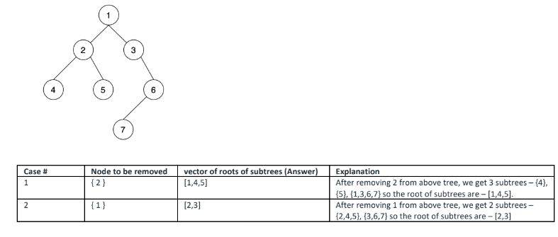
Problem Statement
Given a binary tree with unique integer values. Return the vector of roots of subtrees formed after removing the given node.
Vector<Integer> removeNode(Node root, int nodeToBeRemoved)

Slide 5
Solution
The given problem can be solved by a 3 step process :
Find out the node to be deleted by traversing the tree
The left and right children of the node to be removed if exists would be the new roots
If root is not the node to be deleted then it would be the third possible root
There are a few edge cases :
The given tree is empty
Root is the node to be deleted
The node to be removed doesn’t exist

Slide 6
Algorithm
If root is null throw an exception
If root is the node to be deleted
Return a vector with left and right child of root (if exists). Return an empty vector if left and right child are non existent
Else
Recursively find out the node to be deleted
Detach the node from its parent
Return a vector with left and right child of the node (if exists) along with the current root of the larger tree
If the node to be deleted is not found
Return a vector with only the existing root

Slide 7
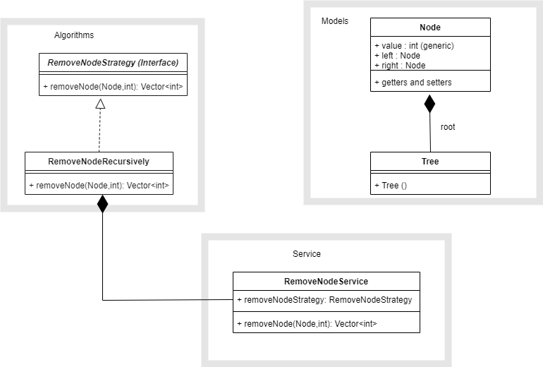
Low Level Design

Slide 8
Code Walkthrough

Slide 9
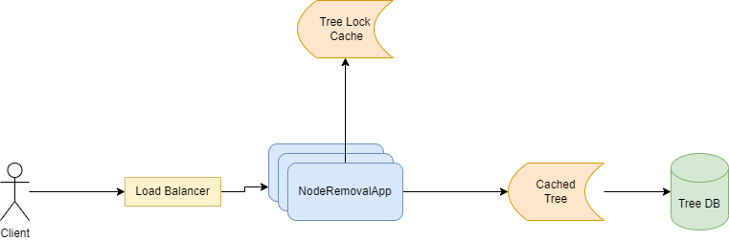
High Level Design

Slide 10
Storing the tree and Scalability
Before we go on to find a storage strategy for the tree, let’s clarify a few questions :
Can there by multiple trees or one tree ?
The question talks about non-duplicate values in a tree. What about cross tree values ? Can there be duplicates ?
Should we allow parallel updates to the same tree ? (subtree locking concept) This might have an effect on the response latency.
Is remove node the only operation or do we want to do some other tree based operation like insert, update etc. as well ?

Slide 11
Storing the tree and Scalability
One way we could store the tree in an RDBMS is as follows
Advantage of storing it this way, is single node operations are very fast like in our case (remove node). But what if there are multiple trees ?
We can associate a tree id column for each node row. However, when we delete an existing node, new trees are created, which means all rows in the subtree should be updated.
Why not use a graph database like neo4j ? They provide out of the box solution for tree and graph based operations.
Node_id | Node_val | Parent_id

Slide 12
Questions and Answers

